Slide 1
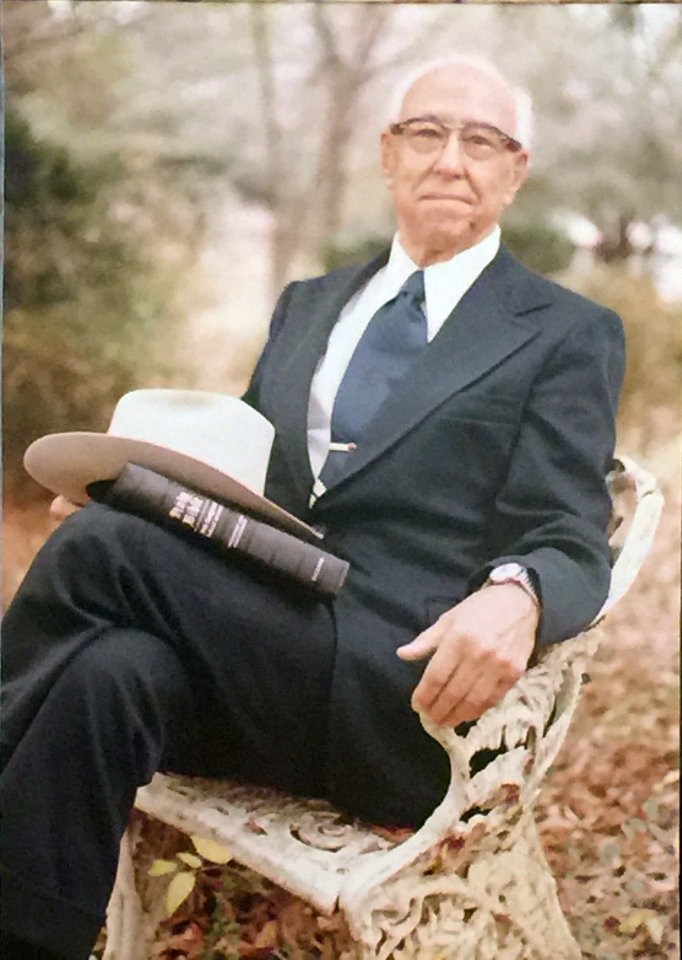
The Sage Of Jasper: Bunion Augustus “Gus” Nichols 1892-1975

Slide 2
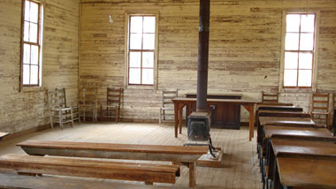
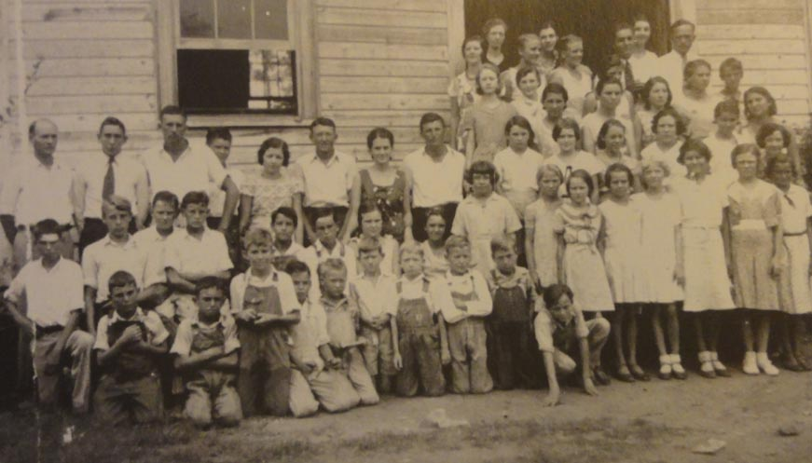
Humble Beginnings
Born January 12, 1892
Rural Walker County, Alabama
The oldest of 10 children
Attended one-room school on Iron Mountain a few winters
Raised among the Baptists
Taught truth by cousin - Larkin Wyers
1908 - Joined the Baptists At 16
Notes:
Born to William Calvin & - the oldest

Slide 3
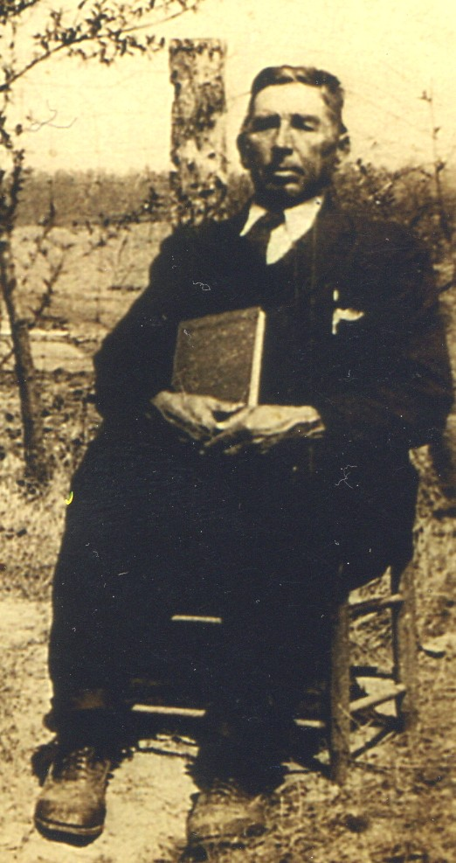
A Young Man Of Talent & Promise
Could play any instrument & memorized Showalter’s Rudiments Of Music
Taught Singing Schools with uncle, Sam Wyers
1909 – At Iron Mountain School where Nichols obeyed the gospel under C.A. Wheeler
1912 – Finished 7th, 8th, 9th grades in 6 wks.
Charlie A. Wheeler
1851-1937
Gus At 20 yrs old
Notes:
He had just finished a singing school when CA Wheeler came to Iron Mountain Schoolhouse – C.A. Wheeler had been converted in 1880 under preaching of J.H. Holbrooke.

Slide 4
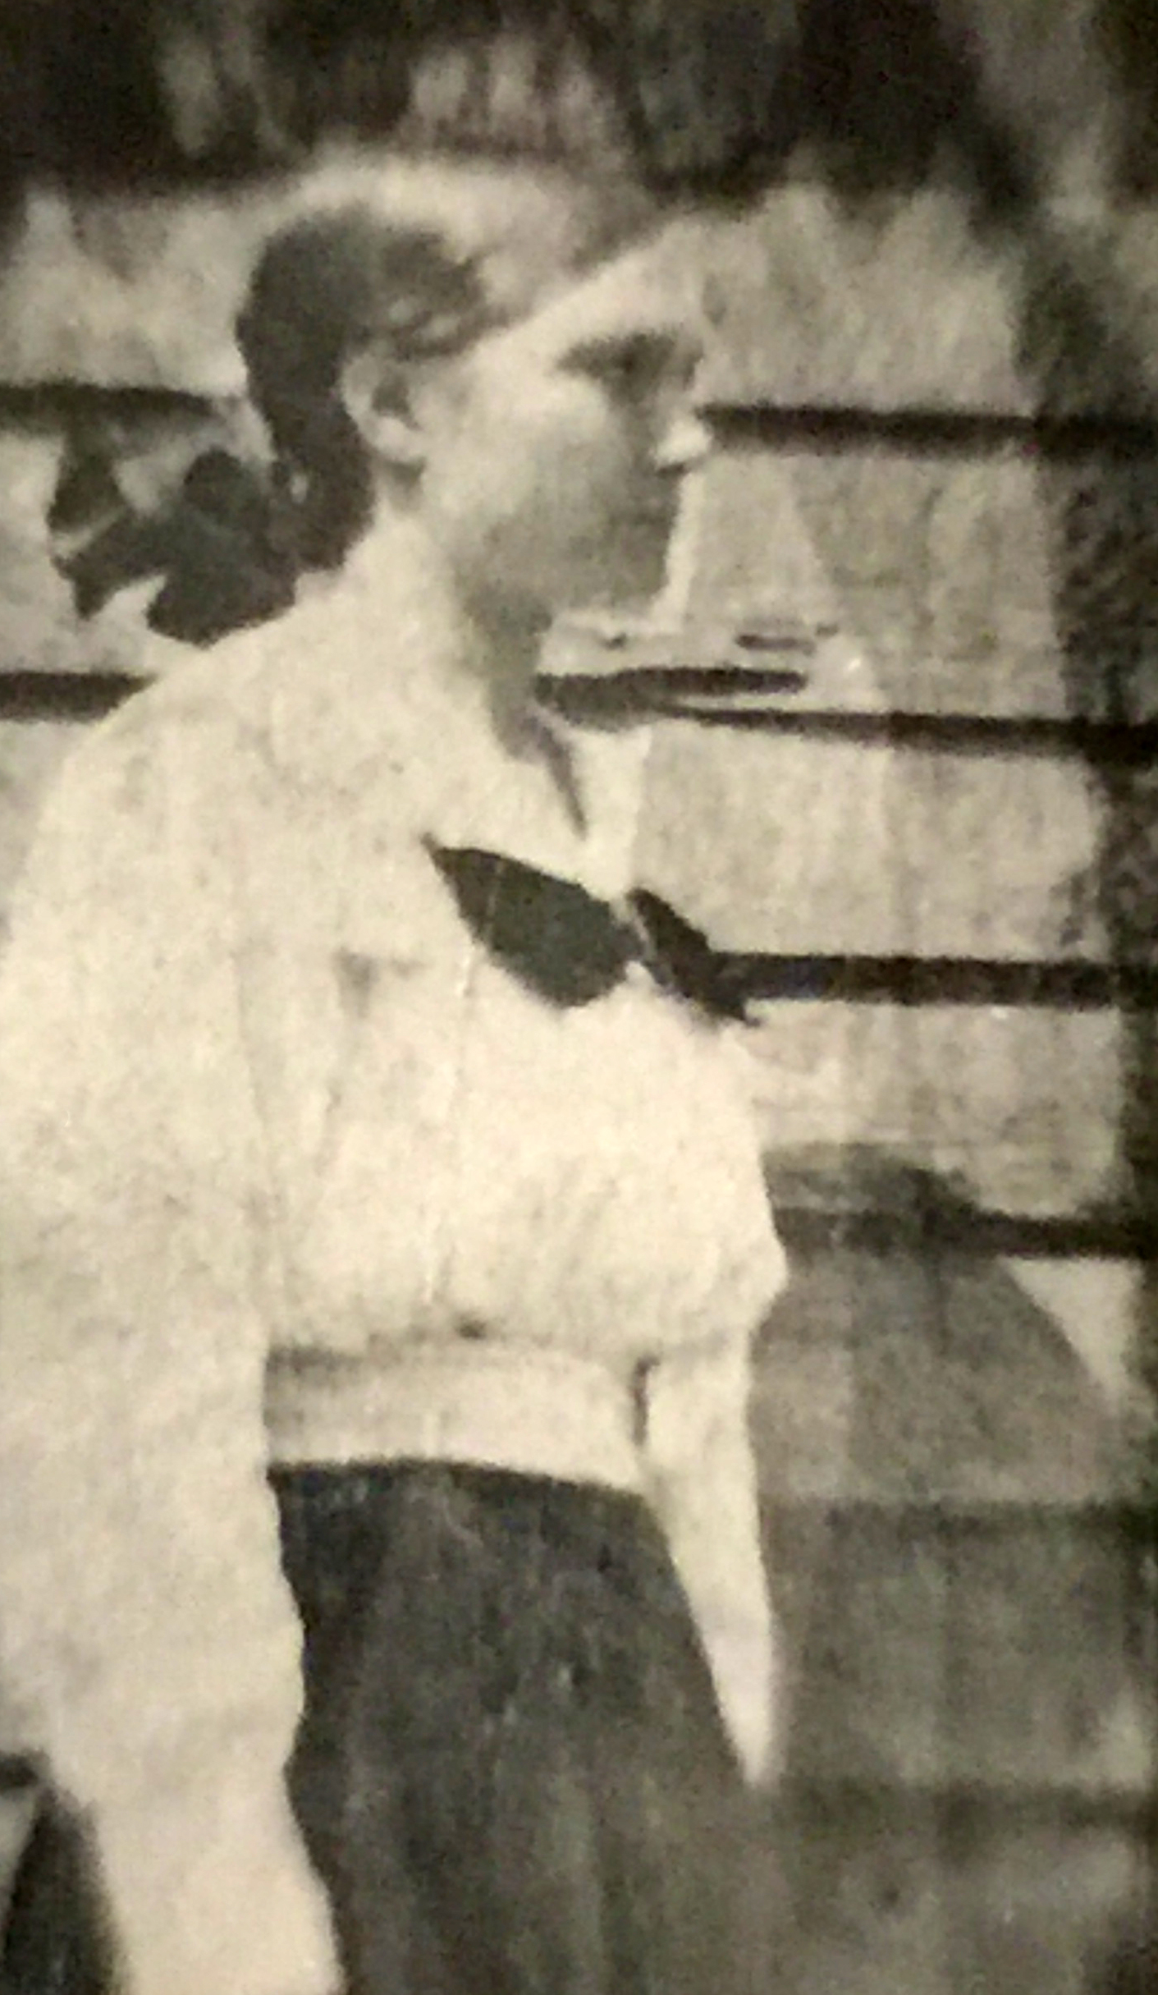
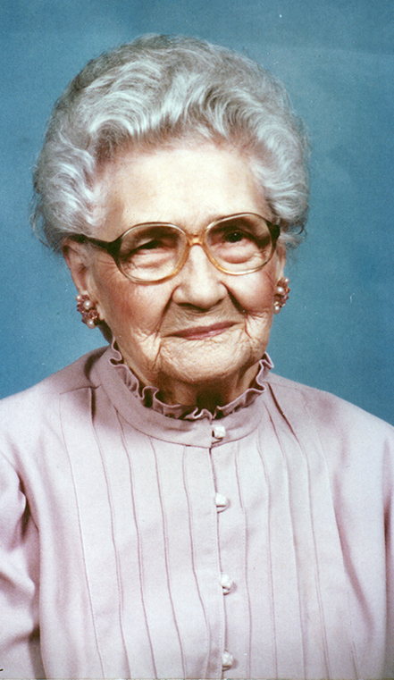
Matilda Brown (3.29.1894-10.6.1991) 97 years!
Married November 13, 1913
Gus – 21 & Matilda - 19
Converted Matilda
Eight Children
Gracie – 1915, 4.27
Vodie – 1916, 9.10
Flavil Hall – 1919, 2.2
Bertha – 1920, 10.1
Carrie – 1923, 3.11
Foy Wallace – 1924, 10.15
Hardeman – 1928, 3.16
Hudson – 1930, 1.29
Notes:
p.71 – In 1924 Gus sent in a report to Joe Warlick about his work in Cordova to Texas preacher, and the editor of the Dallas based paper, Gospel Guide. Warlick observed,
Bro. Gus Nichols, of Cordova, Ala., writes us with his renewal. He says he has had a good year, and some sixty have been baptized, and much other good accomplished. Gus is a good boy, and safe in every way. He has one of the best women for a preacher’s wife that ever lived. I can prove this by Bro. Frank Baker, who knows her well.
I have a wonderful poem Gus wrote concerning sister Matilda on page 27.

Slide 5
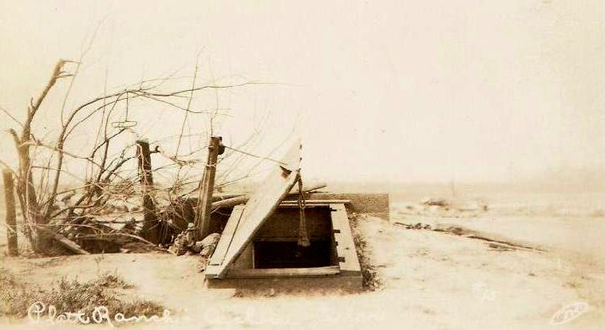
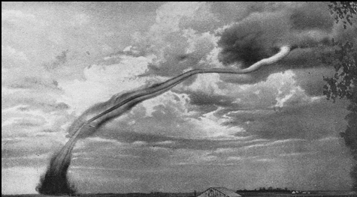
May 27, 1917
F3 Tornado - 3 miles wide – 17 miles long –Kills 6, Destroys 200 homes In Carbon Hill
“In the year 1917 a tornado destroyed our home, blew us away and ruined our crops out on a farm before it tore into Carbon Hill, Alabama and left the dead and the homeless in its wake. But we did not give up and quit. The next spring we found ourselves planting again, and soon we were growing a crop.” -Gus Nichols, World Evangelist, 11.5.1974,
Notes:
Page 33

Slide 6
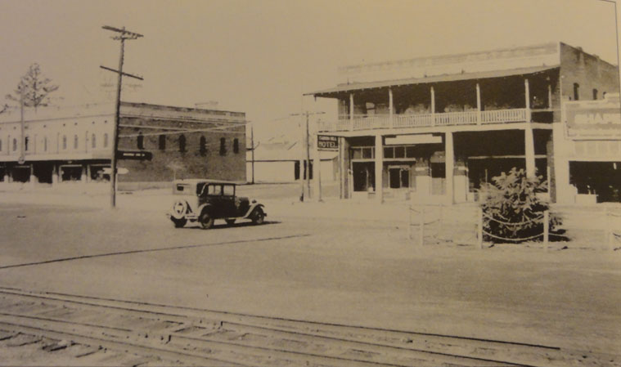
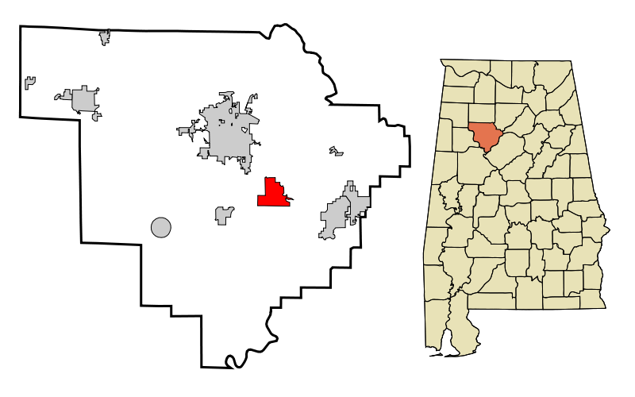
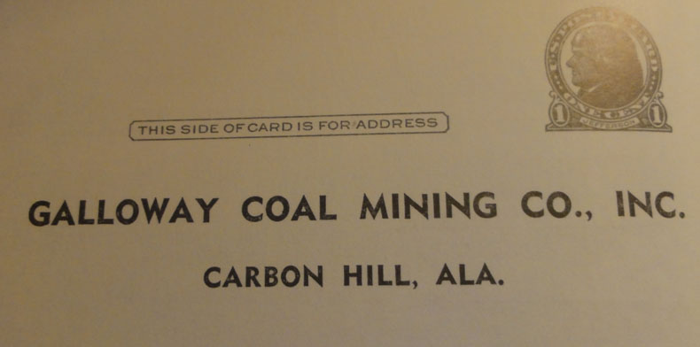
Carbon Hill, Alabama
1917 – Preached 1st Sermon
1917-1919 – In The Mines In The Winter
Notes:
1917 – Preached his first sermon – page 34 - It was the second Sunday in June; just fourteen days after his life-threatening experience that he stood before the brethren to present his first sermon. Approaching the makeshift lectern, he held in his hands a cumbersome outline of seven pages full of notes. There were no topic headings, nor were there any numbered points. He had just filled each page with text. When he started speaking, he quickly realized that his effort to make good eye contact with his audience caused him to lose his place in his outline. Thus, he folded his notes and placed them in his pocket and proceeded to speak the word from memory.
His preaching was well received by those in attendance, though a neighbor who was there asked him if he remembered fiddling with the buttons on his jacket while he was preaching. Having not realized it, the fellow proceeded to tell him he had buttoned and unbuttoned his jacket fifty-seven times.
1917-1919 - In the mines. Years later, in a sermon, he recalled it in view of illustrating the horrible existence of being outside of a relationship with Christ,
O! It is a horrible feeling to find that you are lost! I also was lost in a coal mine once. My light went out as I was going in by myself following an old man-way, and I could not get my carbide lamp to burn again. I had to feel my way for perhaps a quarter of a mile in the blackness of darkness. How I would have welcomed a guide and a light! I was in danger of straying off into some old worked-out entry where there was no fresh air, and where the top would be falling in, and where I might starve to death. The joy I had when I finally found my way to the trap-door into the main entry where there were beautiful electric lights was surpassed only by my salvation from my sin when I obeyed the gospel, and, like the Eunuch, went on my way rejoicing.7

Slide 7
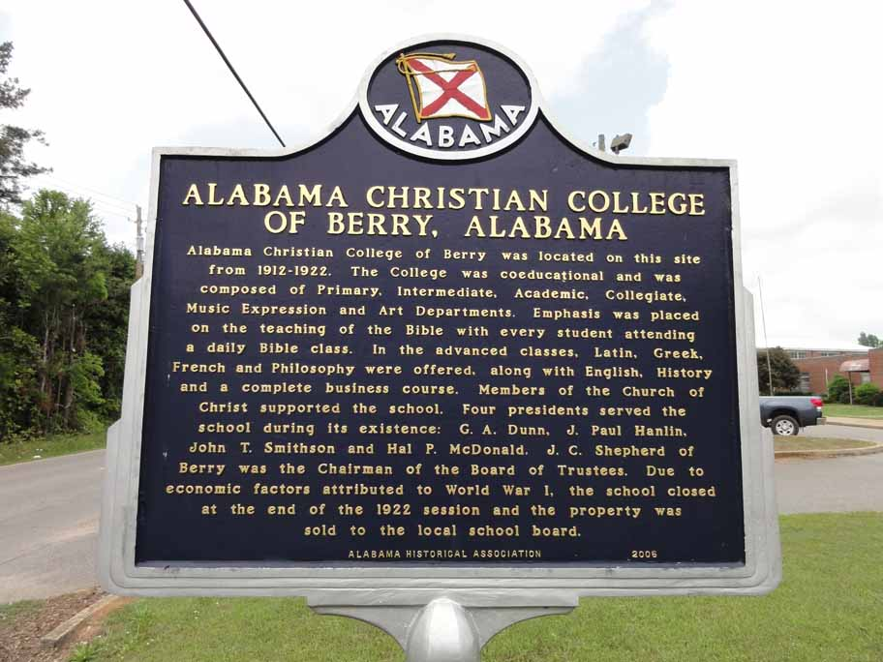
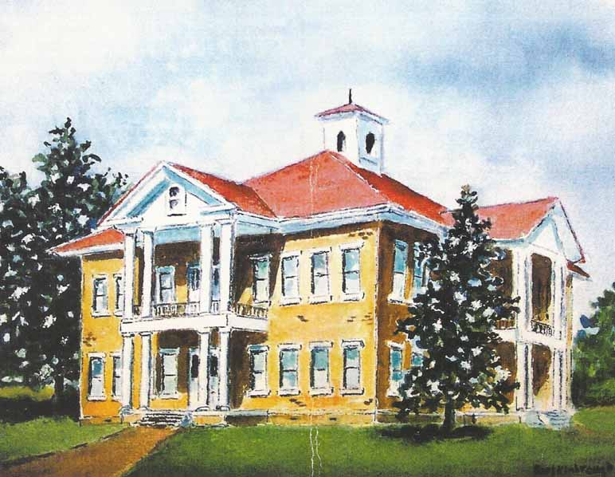
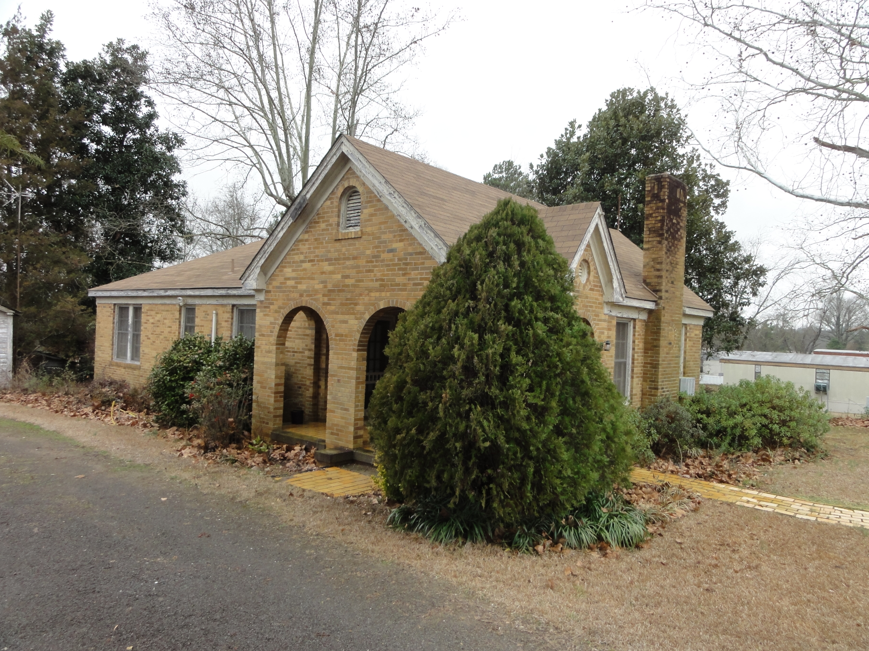
Alabama Christian College – Berry
1912-1922
Artist Rendition - by Earl Kimbrough
Built 7 Acre Farm/House /Barn/Well/Large Garden
1918-1922
Charlie & Gus attend Alabama Christian College
Nichols Home In Berry
Notes:
[.44 - School had been founded by G.A. Dunn in 1912 (3 yrs to the end of 1915. J. Paul Hanlin for a year after.
Hal P. McDonald ran the school in the later years.
Attended parts of four years – fall & winter quarters – other times he was farming and preaching
Frank Baker, J.B. Nelson, J.D. Tant and others.
Five Brothers –preach – Carey, Charlie, Gus & Pervie, & Archie (part time)

Slide 8
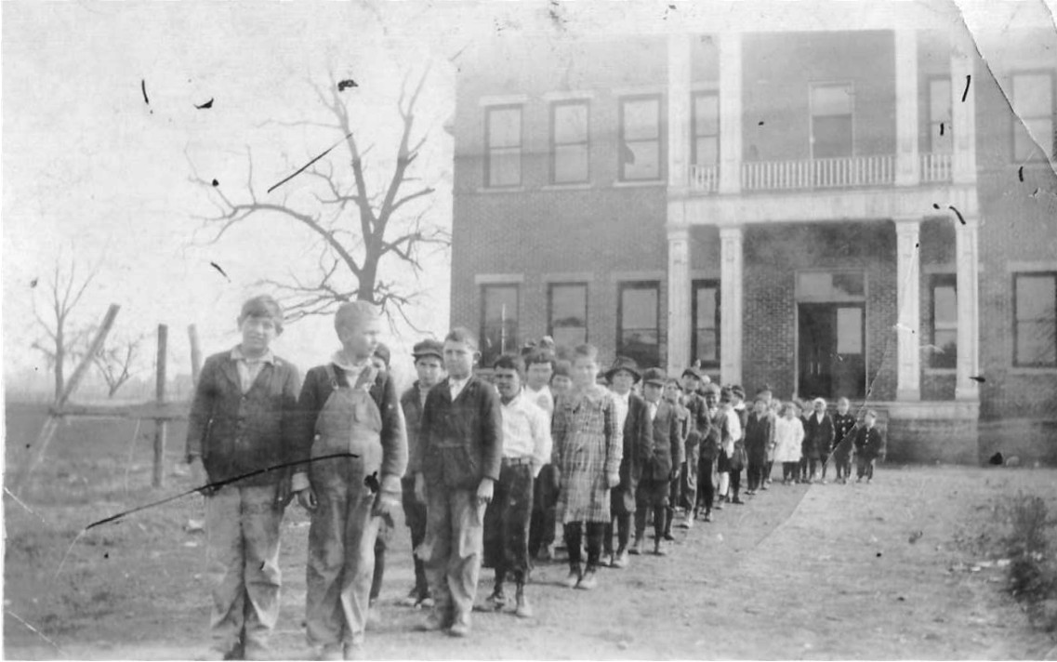
Alabama Christian College – Berry
1912-1922
GA – Vol 64. #12, 1922, p.273, Perhaps Nichols’ First Report To The Gospel Advocate
Notes:
Attended parts of four years – fall & winter quarters – other times he was farming and preaching.
KATE - p.48 - I remember Flavil visiting our home in 1976, after the death of his father. He spoke of his the days at Berry, when his parents had purchased a farm that backed on the railway. Told about Kate, the mule that helped Gus learn the Scriptures. & about how Kate helped him get to and from meetings.

Slide 9
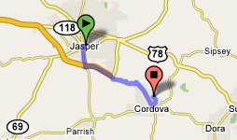
1924-1926 Cordova, Alabama
Held A Meeting in Jasper – Est. Church – Preached EverY Sunday Afternoon at Jasper Until Departing for Lamar County in 1926
Notes:
Chapter 10 - Cordova – p.65
Avery Fike told the story – p.78 – “Wednesday after the meeting started, I was walking down the street and in front of the Christian Church, I saw an arrow drawn on the sidewalk with crayon, which said, “GOSPEL MEETING, FOLLOW THE ARROWS.” This had an interesting ring to it, and through curiosity, I followed the arrows around the block to the foot of the stairs where the arrow pointed upstairs. I followed on, and wound my way around, and around, until I came to a door upon which was tacked a notice which said, "GOSPEL MEETING— SERVICES 7:30 P.M. each evening. WELCOME. Gus Nichols Minister, Cordova Church of Christ." I departed and passed down by the Post Office and received a card from Brother Nichols stating that he had heard I was a member of the Church of Christ and it contained an invitation to come to the meeting. That night my wife and I and our three babies were at the meeting. That night marked the beginning of my connection with the congregation and the work here.” page 78

Slide 10
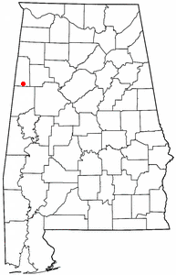
1926-1932 To Millport, Lamar County
Begins Circuit Preaching With Churches – Three Each Week For 1st 2 Years
1927 – Report to GA - Preached 336 Times & 3 Bible Classes Each Week

Slide 11
GA Reports
1928 – Preached 294 times/ 47 baptisms/24 restorations -GA-1.24.1929, p.81
1929 – Preached 13 mtngs/310 sermons/86 baptisms/184 discourses at mission points -GA-12.26.1929, p.1232
Notes:
p.102 - Christian Chapel – Golden and Ruby Curry were members at Kingville, and wanted a church nearby. Flavil once recalled the occasion when Golden was asked to lead the closing prayer.
Like many Christians, brother Curry often said in such dismissals, "Our Father, we thank thee for this hour we have spent in Thy service." But having noted the length of the particular service, he blurted out, "Holy Father, we thank Thee for this two hours and fifty-seven minutes we have spent in Thy service!!!”
Many of the Blacks and Hester preachers are buried at Christian Chapel.

Slide 12
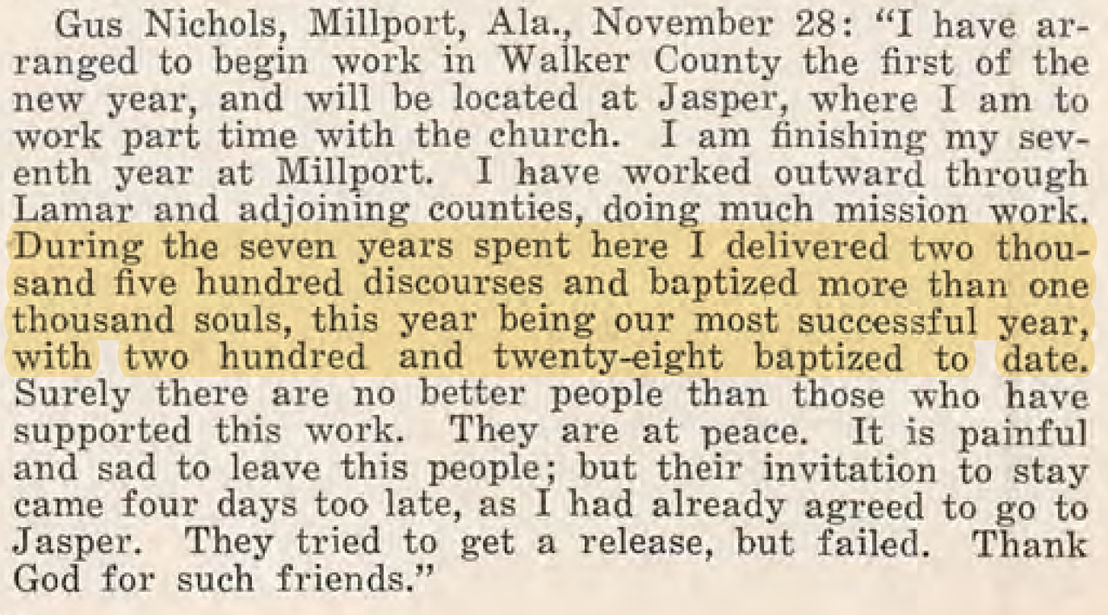
GA Reports
1930 – Meeting at Cordova with 53 Baptisms -GA, 1930,p.969
1930 – Visits Freed-Hardeman – writes first article about visit in GA, 7.3, p.639
GA, Dec. 15, 1932
Notes:
“Gus Nichols, Millport, Ala. November 28: I have arranged to begin work in Walker County the first of the new year, and will be located at Jasper, where I am to work part time with the church. I am finishing my seventh year at Millport. I have worked outward through Lamar and adjoining counties, doing much mission work. During the seven years spent here I delivered two thousand five hundred discourses and baptized more than one thousand souls, this year being our most successful year, with two hundred and twenty-eight baptized to date. Surely there are no better people than those who have supported this work. They are at peace. It is painful and sad to leave this people; but their invitation to stay came four days too late, as I had already agreed to go to Jasper. They tried to get a release, but failed. Thank God for such friends.”

Slide 13
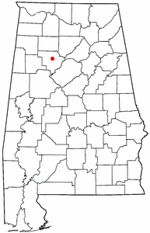
1933 To Jasper, Walker County
For The Last 43 Years Of His Life

Slide 14
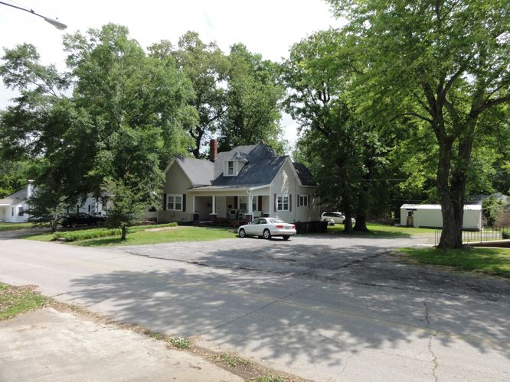
New Building Had Been Built On 5th Avenue & 15th Streets
5th Avenue Church of Christ from 1926-1956
Nichols Home Until Early 1950s
He Began Preaching Two Sundays At Jasper Each Month, One At Cordova & One At Carbon Hill

Slide 15
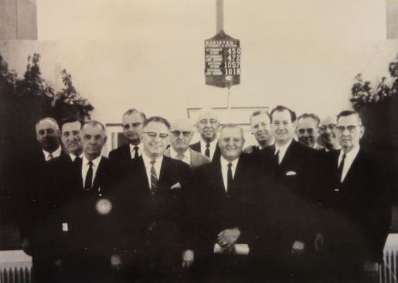
1934 – Training Church Leaders Begins
Jasper needing Elders, Gus Nichols began a class on Friday nights 7-9:30 or ten. Class grew to have as many as 60 or 70 preachers attending on a Friday night. That school is still going as Gus Nichols School of Preaching, with Levi Sides directing it.

Slide 16
Increased National Awareness
1934 – Moderates for C.R. Nichol in debate with Free-Will Baptist, T.D. Dixon, Boston, Ala. – GA, 12.27, p.1224
1935 – writes “The Bible And Silence” – GA, 3.1, p.224
1936 - "WHAT MUST I DO TO BE SAVED?" BY GUS NICHOLS – 32 page tract: A sermon on the plan of salvation. – GA, 2.6.1936, p.142
1937 – First Series of Special Courses At FHC – Gus Nichols attends - & for next 39 years.
1941 – Handles “Query-Box Discussions” during Special Courses.
1942 – Appears Special Courses at F-HC – Jan., Memphis - Feb, Anniston, Al, - Mar. – Debates Holiness O.G. Lodge, B’ham in June, Debates C.V. Headrick, Baptist in Huntsville - July

Slide 17
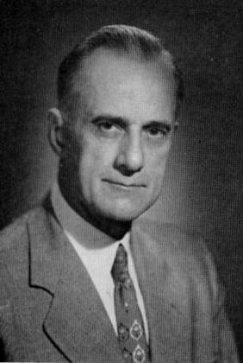
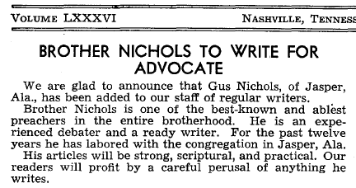
Gospel Advocate Promotes Nichols
1943, May 3-7 – Debate with C.J. Weaver (Holiness) in Huntsville, Ala., Flavil N. Moderator – Transcribed And Reproduced By GA – Boles, Brewer, Nichol, Woods, Promote Book
1944, GA, April 27, p.282 – Front Page Notice
B.C. Goodpasture
Notes:
Page 221 – GN’s report in Truth In Love –
The local radio station in Huntsville was engaged to broadcast the debate. The announcement of this broadcast was made for weeks before the debate, and interest in this feature ran very high. Our people in the Muscle Shoals area were so highly pleased with my defense of the truth the first three nights of the discussion that they arranged and had the last two nights broadcast over the Northern Alabama Net-Work that it might be heard in the Tri- Cities. Some preachers estimated that fifteen thousand people heard the discussion. Loud speakers also carried the discussion to those out of the meeting house who could not get inside.

Slide 18
Years Of Expansion
1945 – January, Begins Appearing On DLC Lectures
Articles by Gus Nichols appearing in most issues of Gospel Advocate
1946 – Begins Holding Meetings As Far As Texas“
1946, Feb. 7 – H. Leo Boles Dies. “I reached the conclusion some years ago that Brother Boles was the greatest man known to me in all the brotherhood.” – GN, GA, 3.28.
Gus Nichols and A. J. Kerr (son-in-law)
at J. W. McGarvey's Grave
Notes:
H. Leo Boles had suffered a severe case of phlebitis. Pneumonia set in on on the morning of the 7th of February. Page 251,252 is an emotionally moving statement in the Advocate recording the deep love brother Nichols had for brother Boles.

Slide 19
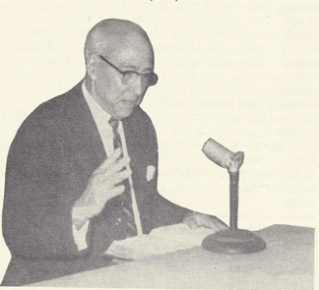
“Words Of Truth” On Radio - 1946
New Radio Station In Jasper, Alabama WWWB1360
Walter Will Bankhead told Nichols that he was starting a new radio station. Nichols told him he wanted to be on the air the first day.
The Gospel Broadcast began at the 3rd hour. 11.2.46
Notes:
p. 241 - The call letters selected for the company were the initials of its owner, W. W. Bankhead. WWWB began broadcasting on the 2nd day of November 1946 at 6am. At the beginning of the third hour on the air that morning, the program, “The Gospel Broadcast,” was introduced with its speaker, Gus Nichols.

Slide 20
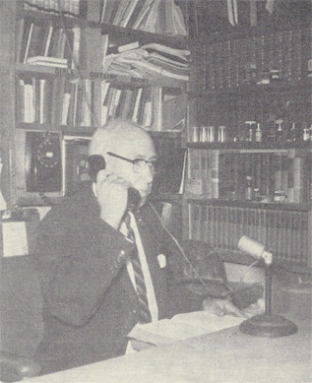
“Words Of Truth” On Radio - 1946
Later a second broadcast at the noon hour - 1956
Broadcast still going with Levi Sides – In its 74th year.
Notes:
Hardeman told about the woman dropping her “teeth” a few years ago.

Slide 21
Years Of Expansion
1948 – Publishes “Sermons” – 66 short sermons coming from newspaper articles – GA, 3.25 p.305
1948 – Assigned Queries Department Editor at GA, taking over from G.C. Brewer, GA, 12.2 p.1156 – 25 years
1949 – Publishes “Sermons” v.2 – May
1949 – Founding Board Member for Childhaven, Cullman, Alabama.

Slide 22
1950,51 – Years Of Debate
May 15-19 – Nichols debates D.L. Welch (Holiness-Pentecostal) Pensacola, Florida.
June 26-29 – Nichols debates Wes Busbee (Pentecostal) in Meridian, Mississippi
July 20 – Baptizes William Woodson
September 11-15 – Nichols vs. J.D. Holder (Primitive Baptist – in Medina, Tennessee (3000 in attendance)
1951, February 20-23 – D.L. Welch – (Pentecostal) Montgomery City Auditorium (debates Welch 5 times)

Slide 23
Proposed Debate With R.H. Boll
Debate on Premillennialism set for July, 1952 between R.H. Boll and Gus Nichols. Boll backs out at last minute, sending Frank M. Mullins of Dallas, Texas to fill in.
Speaks on the Abilene Christian Lectures for the first time – December 8-12, 1952
1953 – Montgomery Bible School is renamed Alabama Christian College at suggestion of GN

Slide 24
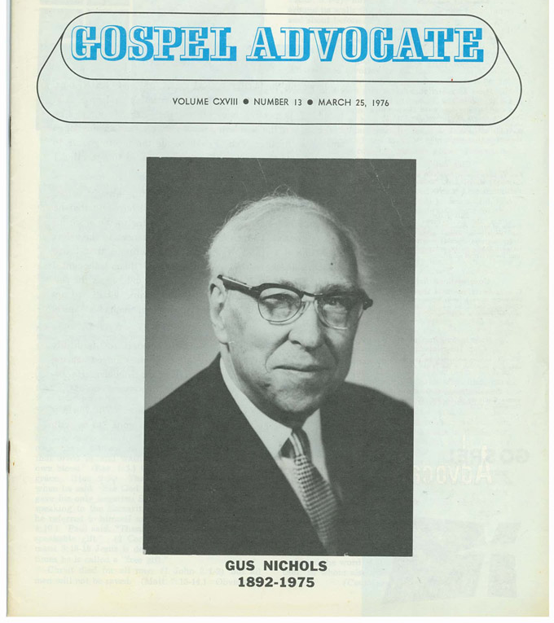
Promoting Gospel Advocate
Begins sending reports of subscriptions as early as 1948,49
1955 – 100th Annual Gospel Advocate Dinner – Standing ovations for Gus Nichols, G.C. Brewer & B.C. Goodpasture
Began program to promote 100k new subs.

Slide 25
Gus & Matilda Nichols after 42 years of marriage
GA- May 19, 1955, p.386

Slide 26
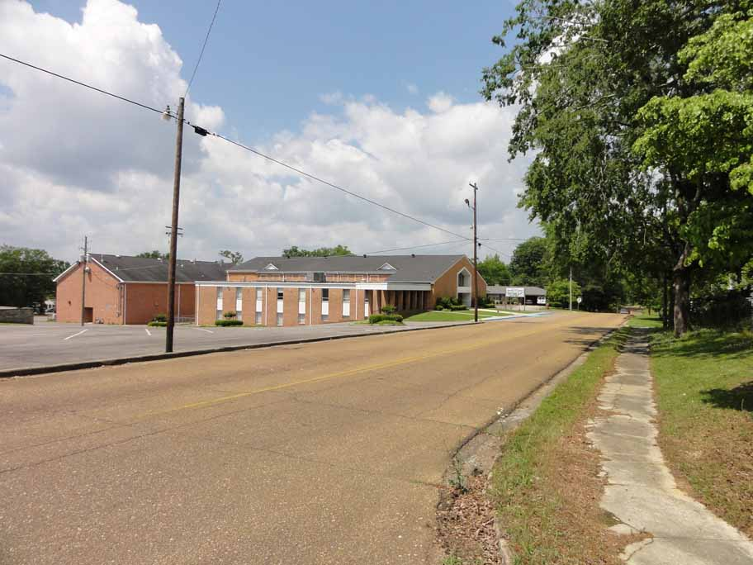
1956
5th Ave Church of Christ becomes 6th Avenue at the cost of $215k

Slide 27
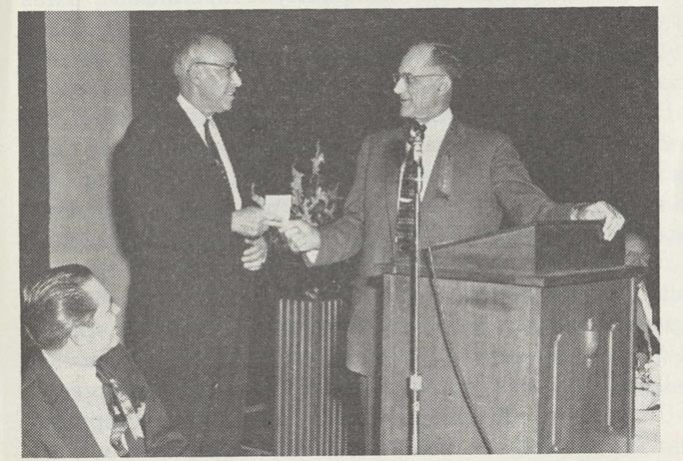
The Promoter Rewarded
1962 – Ira North/Gus Nichols Sub. Challenge – Won by North at 4,761, GN, 3,838. North won $100, but gives it toward a Holy Lands trip for GN. B.C.G. matches contribution
February – Gus Nichols Apprec. Dinner- F-HC Lect’s.
May 5 – Depart for Holy Lands Trip – Returned June 12.

Slide 28
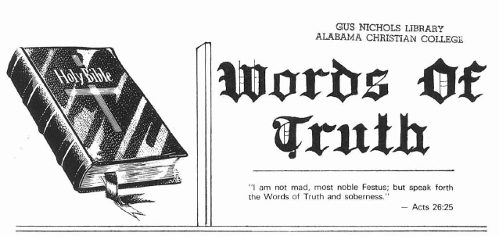
Words Of Truth - 1962

Slide 29
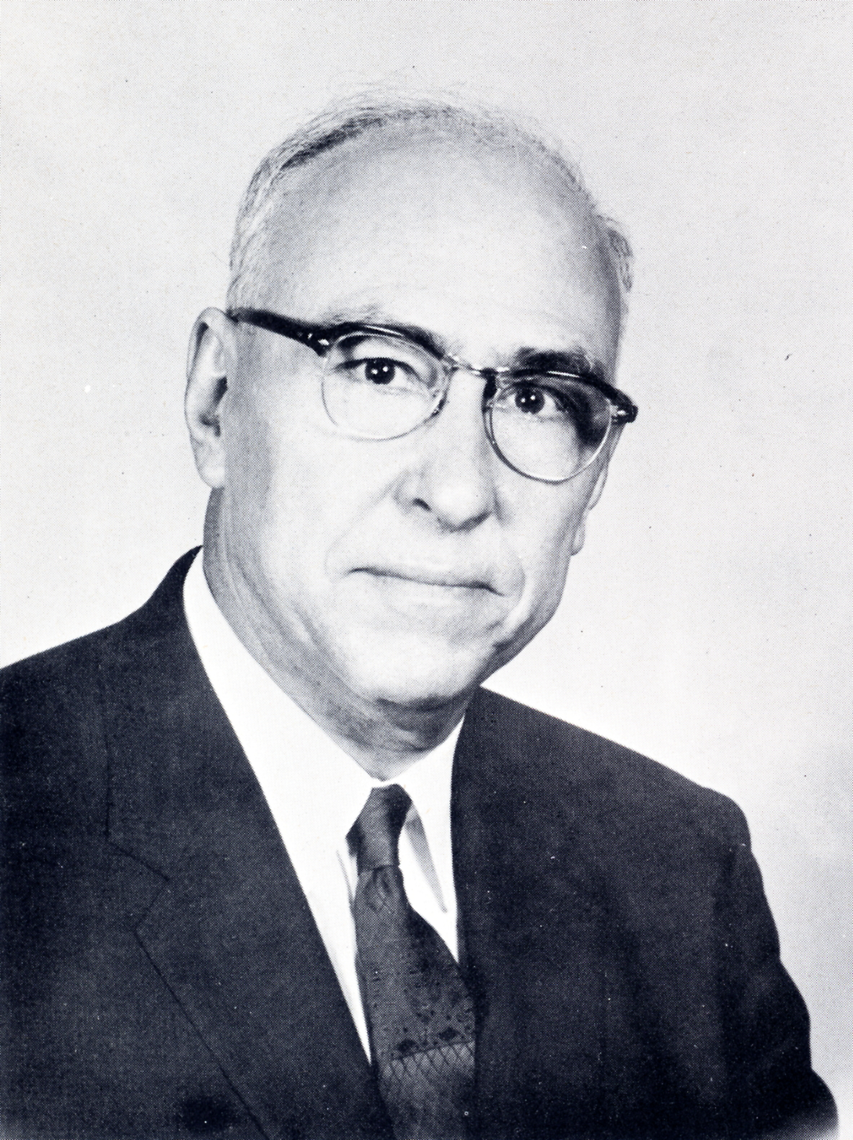
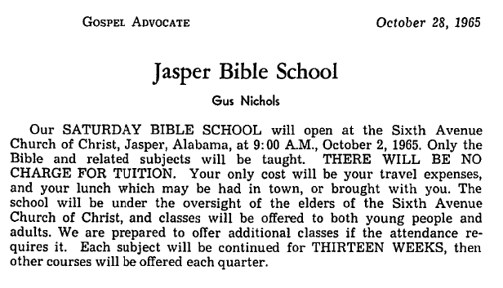
Jasper Bible School - 1965
Saturday School begins at Jasper with Franklin Camp/W.A. Black/Gus N./Douglas Harris/Glen Posey/Paul Wylie/Marlin Howard – An outgrowth of Friday night sessions.

Slide 30
The Accolades
1963 – Christian Service Award – conferred by Pepperdine University
1964 – Honorary Doctor of Laws degree conferred upon by Magic Valley Christian College
1969 – Alabama Christian builds $400,000 library. Named, Gus Nichols Library (June 6)
1969 – Honorary Doctor of Law degree conferred upon by Oklahoma Christian College

Slide 31
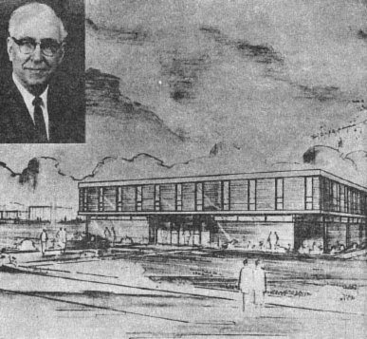
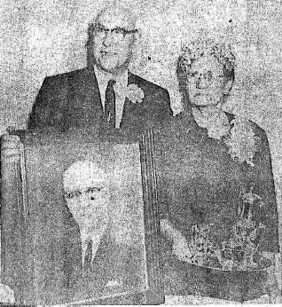
Gus Nichols Library And Learning Center- 1969
Alabama Christian builds a new library at cost of $400,000.00, naming it Gus Nichols Library

Slide 32
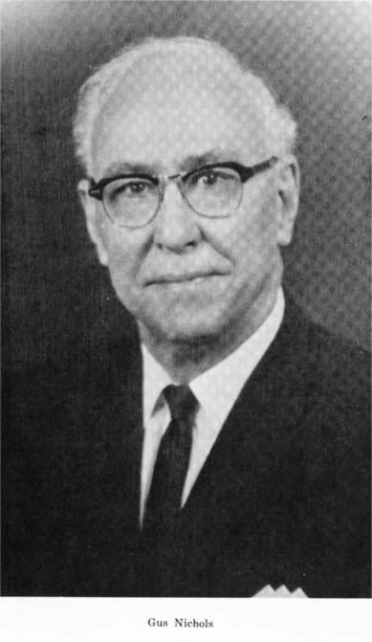
More Accolades
Andrha Pradesh, India, Preacher’s School Library Names Gus Nichols Lib.
Childhaven, Named Gus Nichols Cottage
1957 – Award For Outstanding Christian Service – From Freed-Hardeman Alumni Assoc.
1963 – Outstanding Christian Service Award from Pepperdine University
1976 – Effective Communications Award – (Posthumously) from Abilene Christian

Slide 33
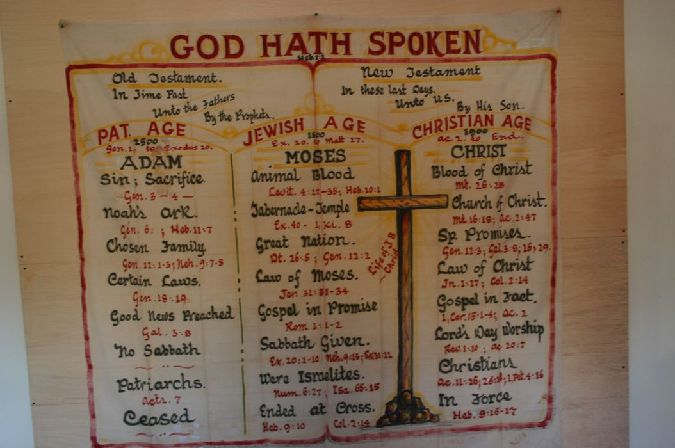
Mid-20th Century “Powerpoint”
Notes:
p.375 – The story of William G. Pemberton (1886-1962). = Pem

Slide 34
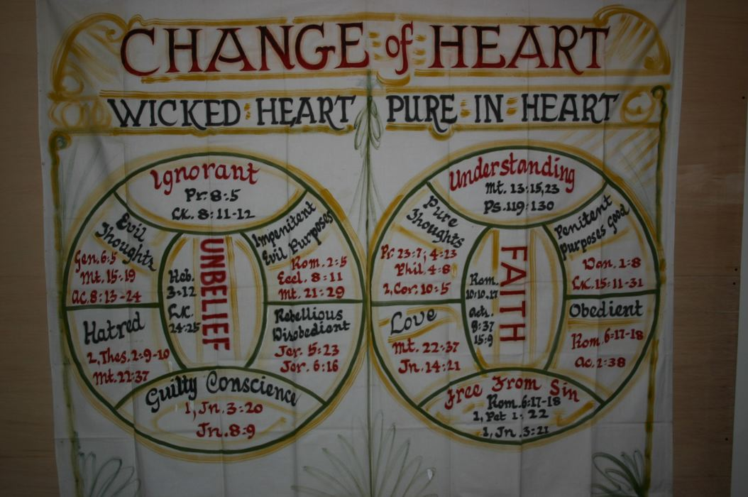
Mid-20th Century “Powerpoint”

Slide 35
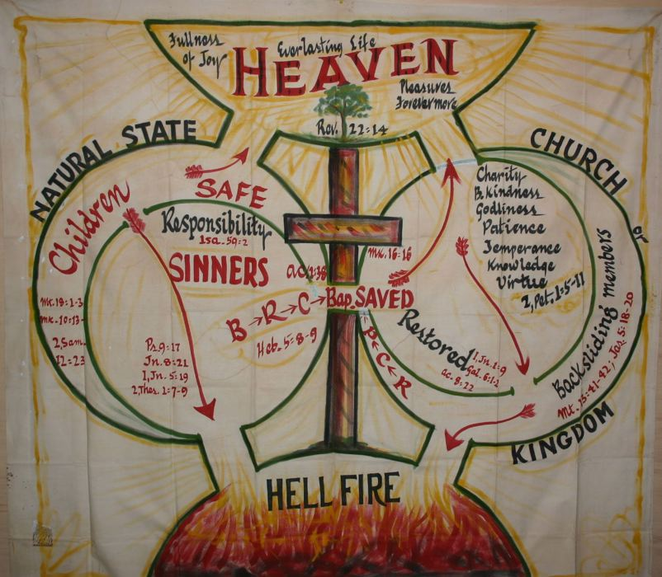
“Mid-20th Century Powerpoint”

Slide 36
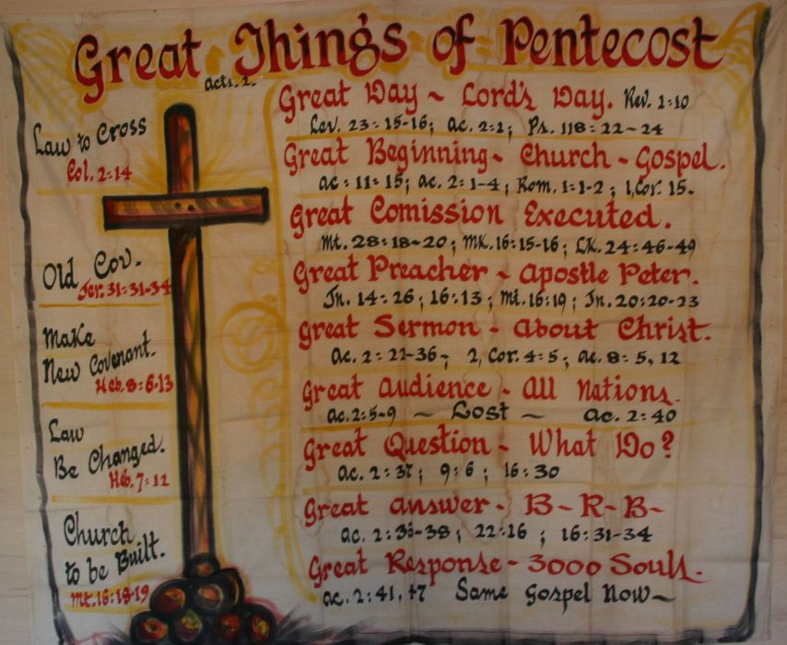
“Mid-20th Century Powerpoint”

Slide 37
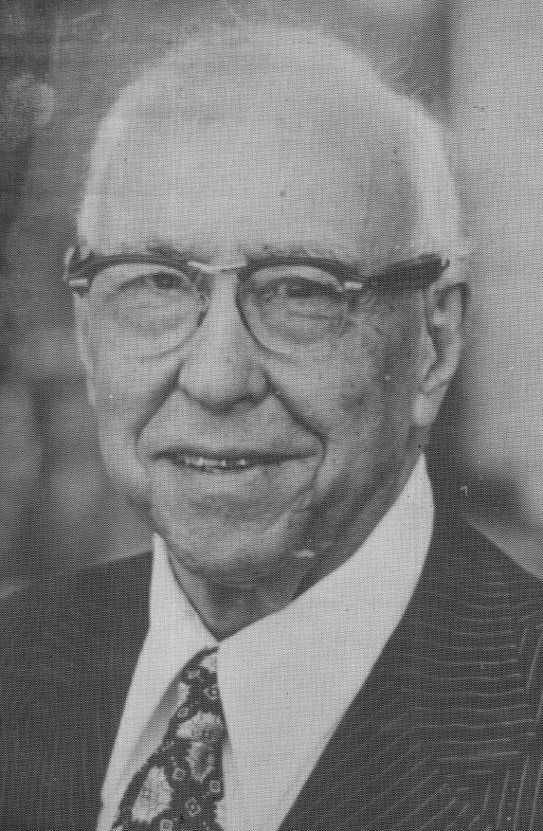
More Accolades
The “Gus Nichols Story” – 30 minute documentary on life, by Herald of Truth, shown nationwide
The Gus Nichols Pavilion – Indian Creek Youth Camp
Preached in 27 States – 4 Countries
Wrote over 10,000 Sermon Outlines
Baptized over 12,000 People
Over 100 Debates

Slide 38
A Preaching Family
Four Brothers Preached: Charlie, Carey, Pervie, Archie
Of Eight Children – 3 Sons preached
Flavil
Hudson
Hardeman
3 daughters married preachers
Gracie – Mrs. Frank D. Young
Vodie – Mrs. A.J. Kerr
Carrie – Mrs. W.T. Hamilton
Over 20 Preacher included ext. family

Slide 39
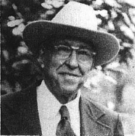
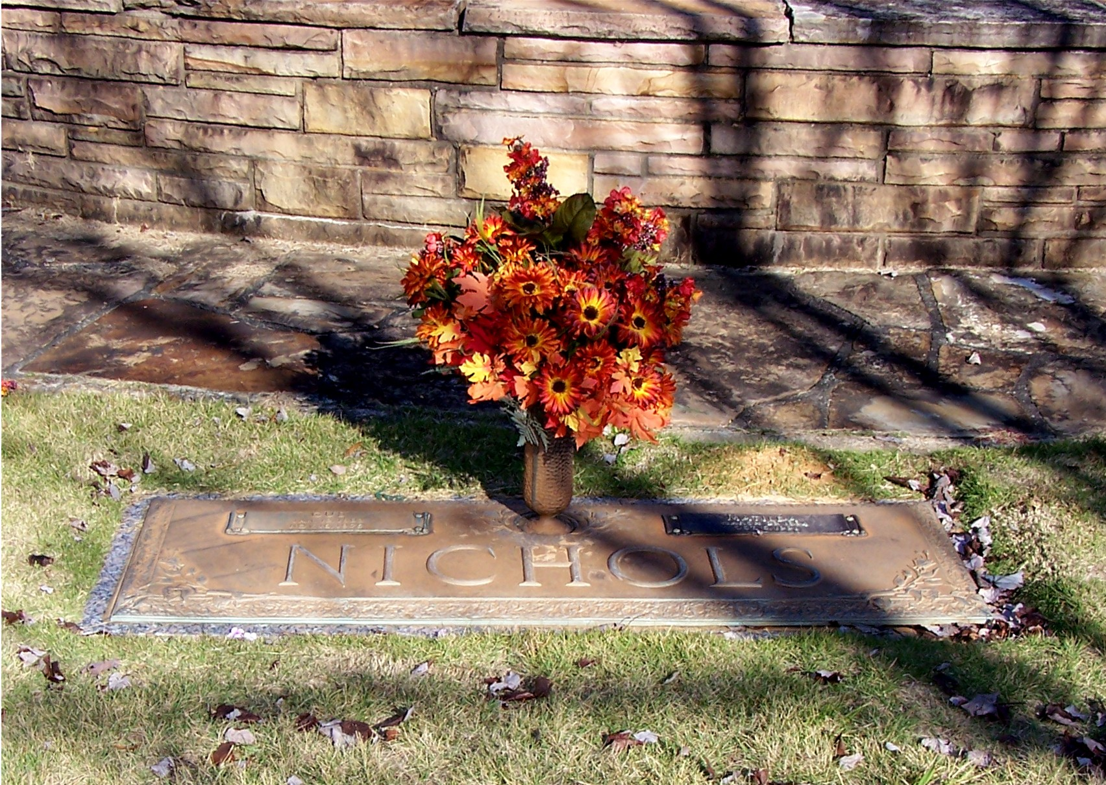
The Soldier Goes Home Nov. 16, 1975

Slide 40
A New Biography
Order at:
TheRestorationMovement.com

